Slide 1
UNIT-3
Types of Data in EDA

Slide 2
Exploratory Data Analysis (EDA):
Exploratory Data Analysis (EDA) is the process of examining and understanding a dataset before applying any machine learning or statistical model.
It helps us discover patterns, detect errors, check assumptions, and understand relationships between variables.

Slide 3
Why EDA is Important:
EDA helps to:
Understand the dataset
Detect missing values
Identify outliers
Find patterns and trends
Check relationships between variables
Select useful features for ML
Without EDA → wrong conclusions and poor model performance

Slide 4
Types of EDA:
Univariate Analysis: Analyzing one variable at a time Examples: Histogram, Box plot
2. Bivariate Analysis: Analyzing two variables Examples: Scatter plot, Correlation
3. Multivariate Analysis: Analyzing more than two variables

Slide 5
Types of Data:
Data in a dataset can be broadly classified into:
1. Numerical Data
2. Categorical Data
Understanding data types is important for:
Choosing correct plots
Selecting ML algorithms
Performing EDA

Slide 6
Numerical Data:
Numerical data contains numbers.
Examples: Age, Salary, Height
Types:
1. Discrete
2. Continuous

Slide 7
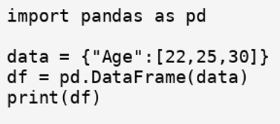
Discrete Data:
Discrete data = countable values Usually integers.
Examples:
Number of students = 40
Number of cars = 10
Number of calls = 5
Students in class: 20, 25, 30, 35

Slide 8
Continuous Data:
Continuous data = measurable values Can contain decimals.
Examples:
Height = 170.5 cm
Weight = 65.2 kg
Temperature = 36.7
Heights: 165.5, 170.2, 180.3

Slide 9
Difference: Discrete vs Continuous:
Feature | Discrete | Continuous
Values | Countable | Measurable
Example | No. of students | Height
Type | Integer | Decimal

Slide 10
Categorical Data:
Categorical data represents labels.
Types:
1. Nominal (no order)
2. Ordinal (ordered)
Examples: Gender, Grade

Slide 11
Nominal Data:
Nominal = no order
Examples:
Gender (Male/Female)
City (Delhi, Mumbai)
Color (Red, Blue)
We cannot rank them.

Slide 12
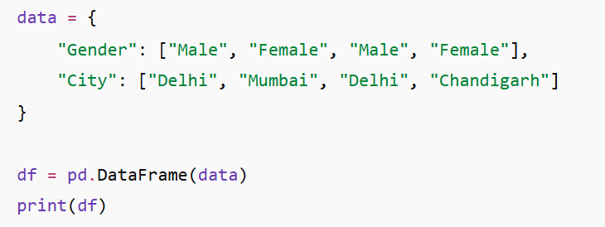

Slide 13
Ordinal Data:
Ordinal = ordered categories
Examples:
Grade: A, B, C
Satisfaction: Low, Medium, High
Education: UG, PG, PhD
Order matters.

Slide 14
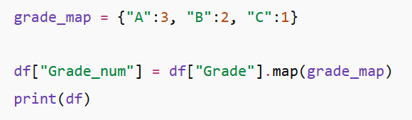
Convert Ordinal to Numbers:
Machine learning needs numbers.

Slide 15

Checking Data Types in Pandas:

Slide 16
Identify Numerical Columns:

Slide 17
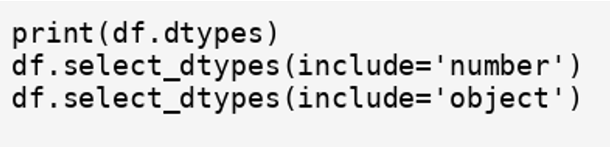
Checking Data Types:

Slide 18

Frequency Distribution (Categorical Data):
To count occurrences of categories:

